Slide 1

Athens University of Economy and Business
School of Information Sciences & Technology: Department of Informatics
Master of Science in “Data Science”
Data Visualization and Communication
“FINAL PROJECT – TEAM 2”
Students:
Maria Grammatikopoulou
Vasileios Dimopoulos
Rafail Mpalis
Dimitrios Tsirmpas
Professors:
Prof. Dimitris Karlis
Ass. Prof. Nikos Platis
Ass. Prof. Konstantinos Bourazas

Slide 2

Introduction
This project analyzes a dataset of bike-sharing rides in Washington Capital Bikeshare to uncover patterns and insights about usage trends.
The dataset includes detailed information about individual rides from May, June, July and August of 2020 2021, 2022, and 2023.
By exploring this dataset, we aim to understand user behavior and gain insights that can help improve service planning, enhance user experience and optimize resource allocation.

Slide 3
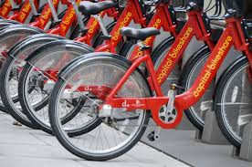
Focus Areas
We focus on:
Identifying the most frequently used start and end stations
Analyzing the duration of rides
Examining the income generated by the bike-sharing service
To achieve our objectives, we implemented several visualizations:
Most Frequent Start and End Stations Visualizations
Duration of Rides Visualizations
Income Analysis Visualizations
Interactive Visualization

Slide 4
Dataset Preprocessing
Manipulation
A script was required to merge multiple .zip files into a final .csv file to consolidate all the data into a single file.
We created new columns to calculate the duration of each ride.
Trips with negative durations were removed from the dataset.
A function was defined to transform ride times into pricing structures.

Slide 5
Dataset Preprocessing
Issues
The scatter plot required data aggregation due to the large volume of data.
The use of the label "docked" bikes for only one month in the entire dataset was assumed to be incorrect, leading to their reclassification as "classic" bikes.
Both Tableau and R encountered issues with the dataset size, causing join operations with other datasets (such as map coordinates) to fail.
The dataset contained huge outliers, such as ride durations extending beyond a month, which were deemed improbable and required handling

Slide 6
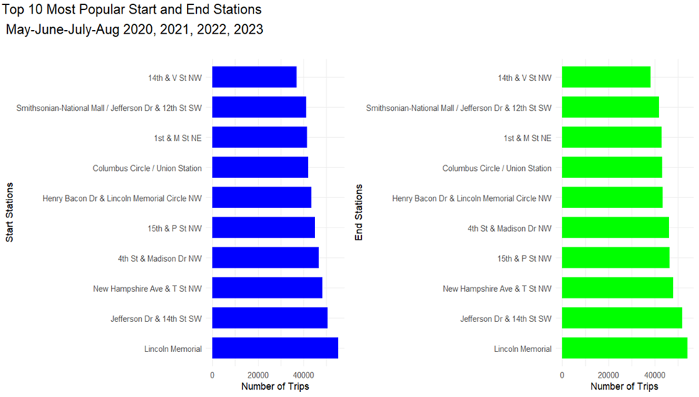
Stations

Slide 7
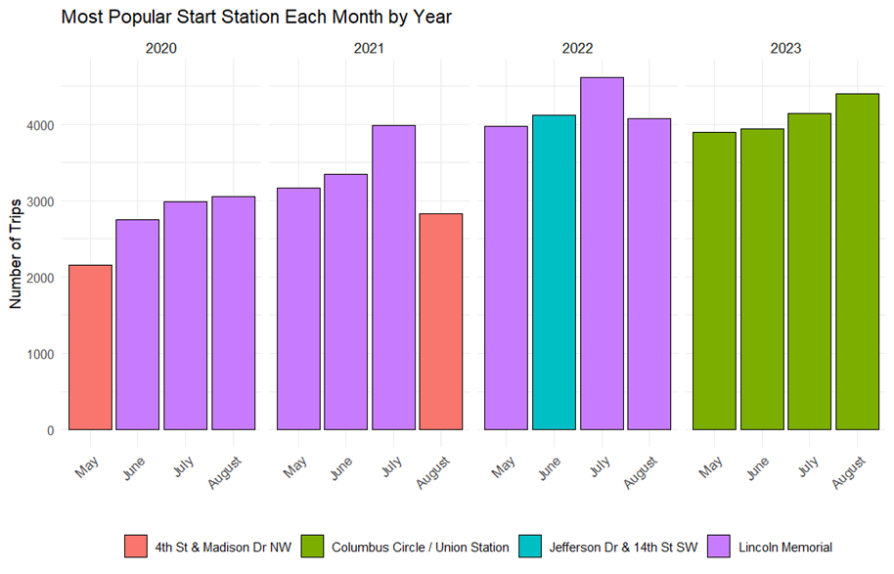
Stations

Slide 8
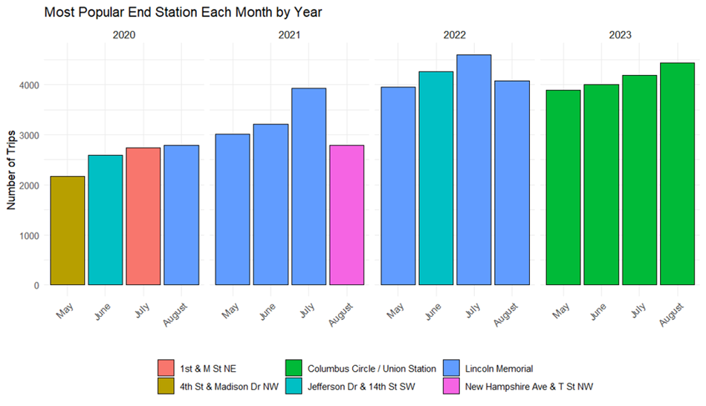
Stations

Slide 9
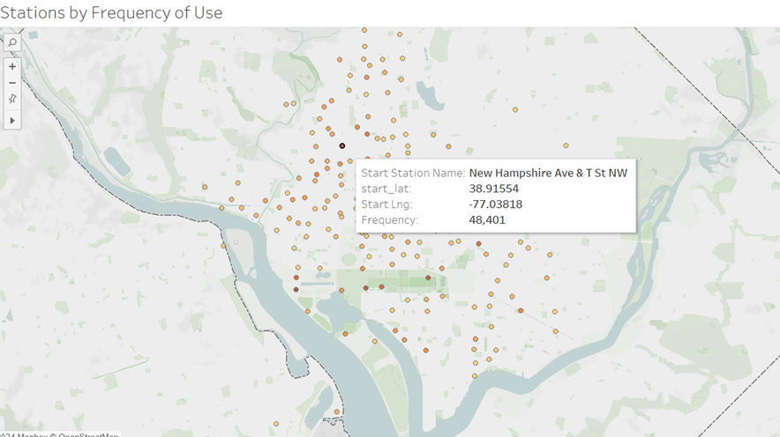
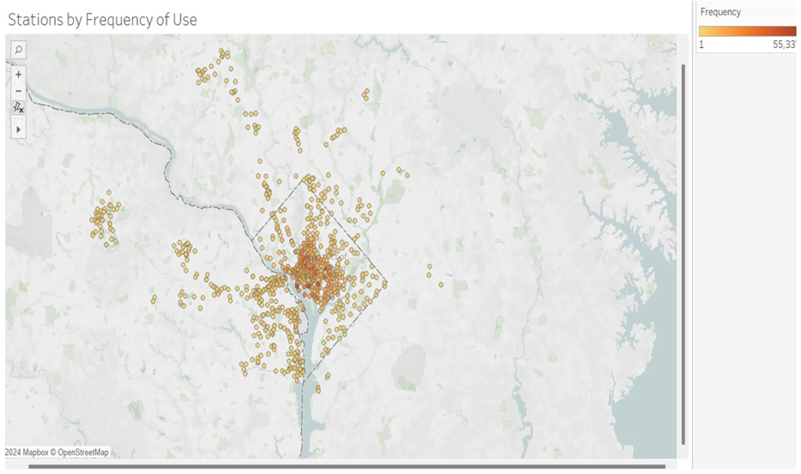
Interactive Visualizations – Stations

Slide 10
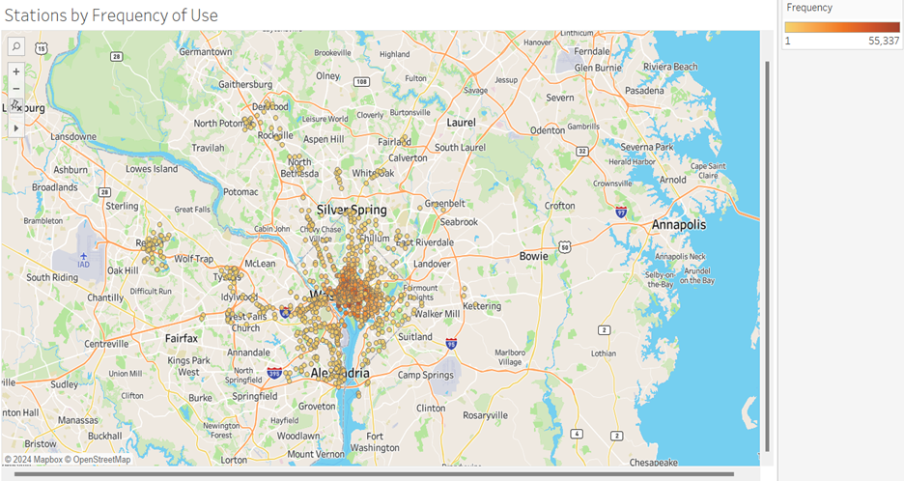
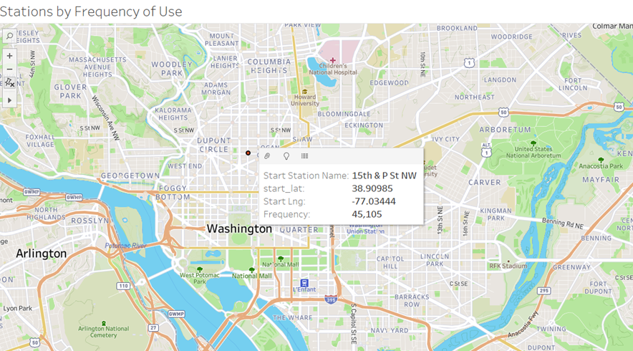
Interactive Visualizations – Stations

Slide 11
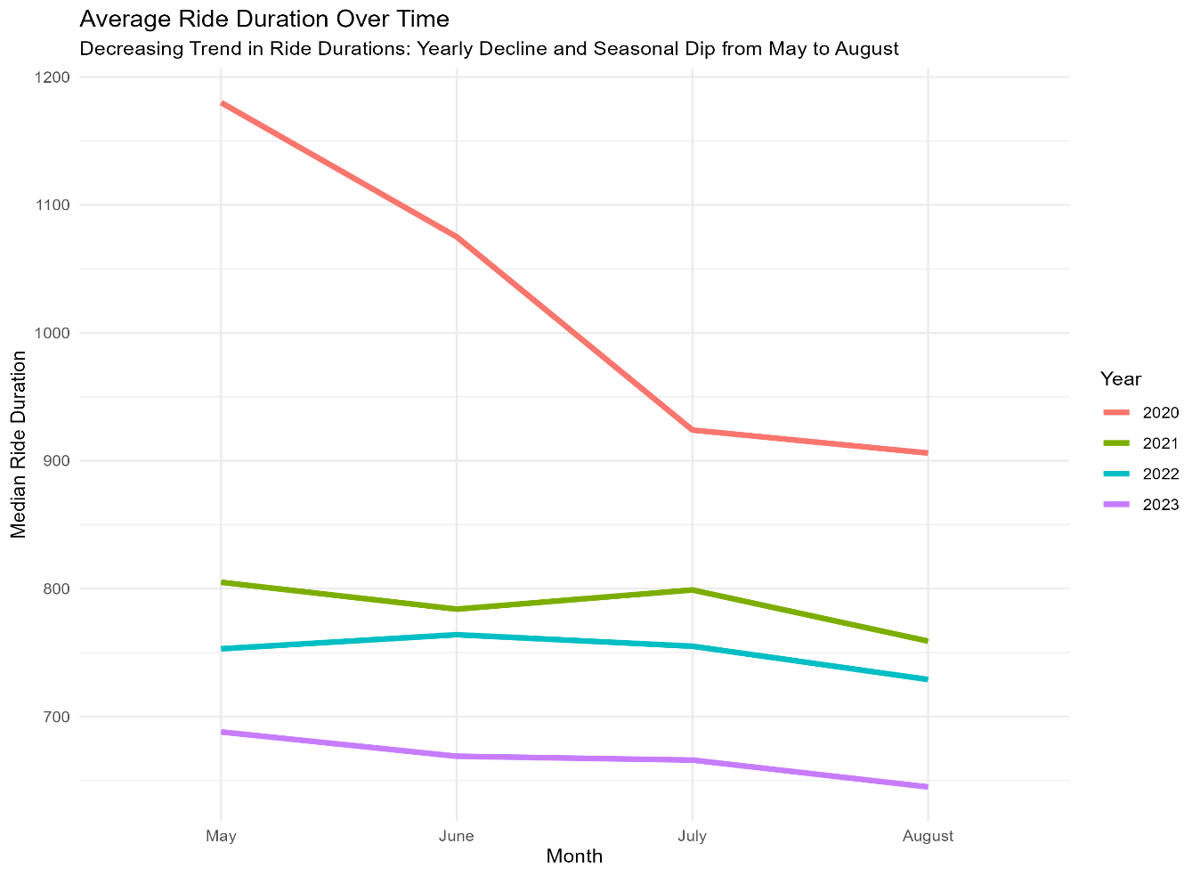
Ride Duration

Slide 12
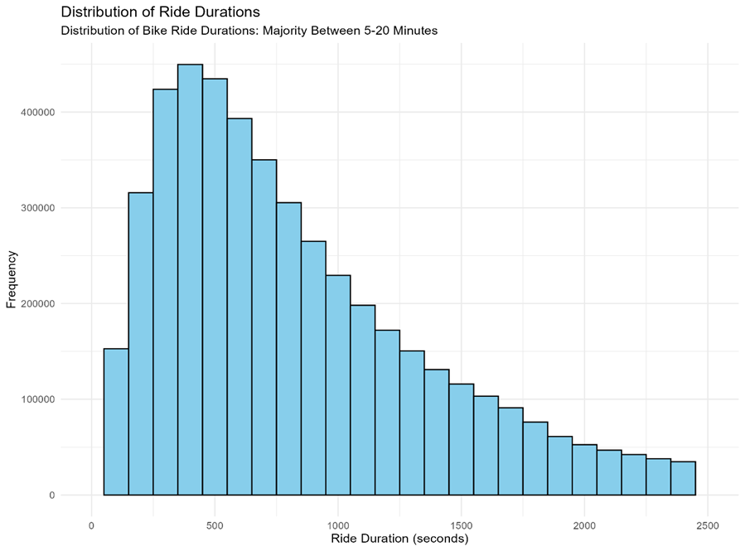
Ride Duration

Slide 13
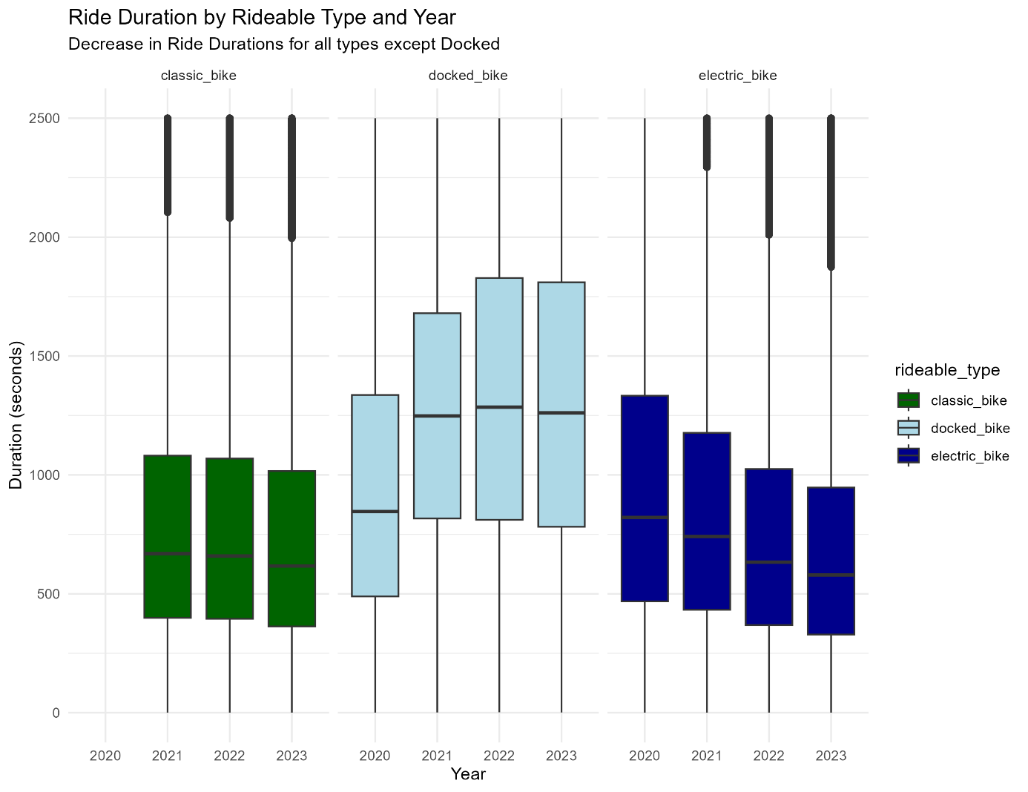
Ride Duration

Slide 14
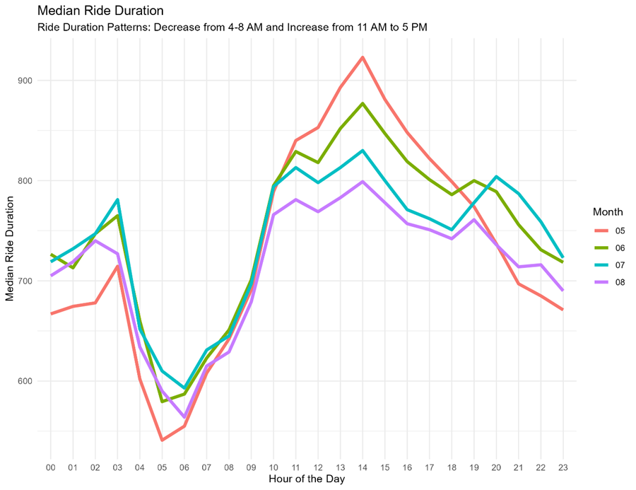
Ride Duration

Slide 15
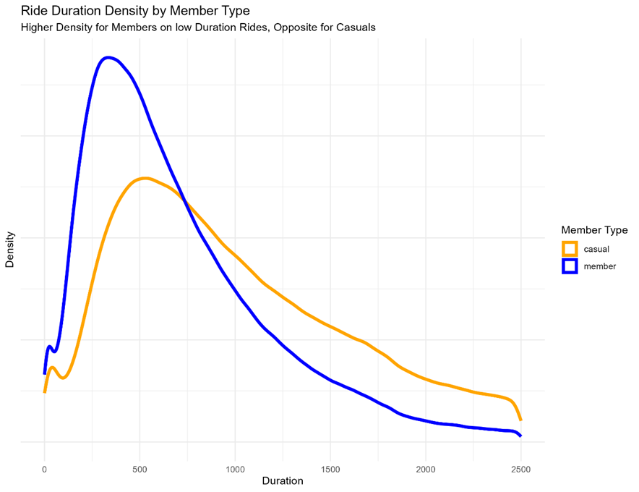
Ride Duration

Slide 16
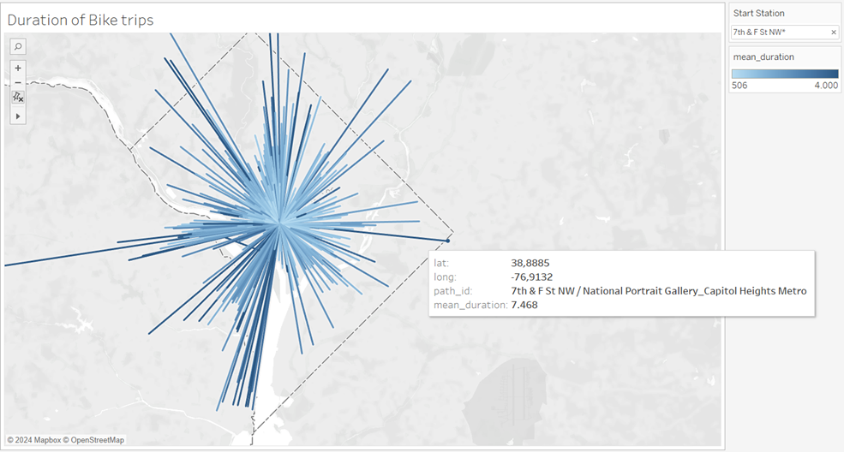
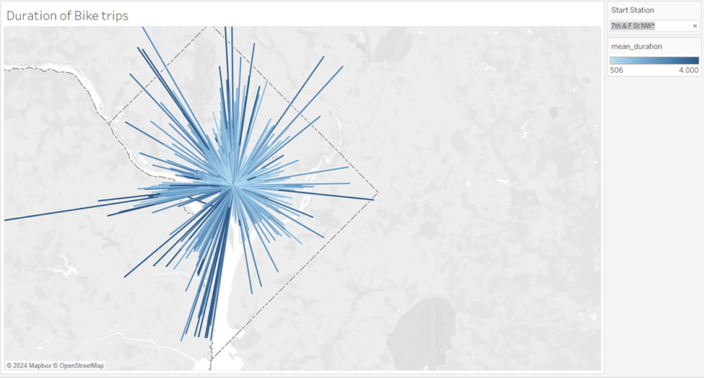
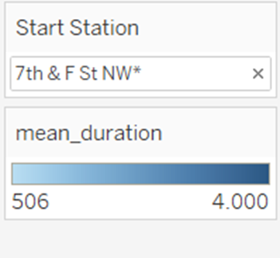
Interactive Visualizations - Ride Duration

Slide 17
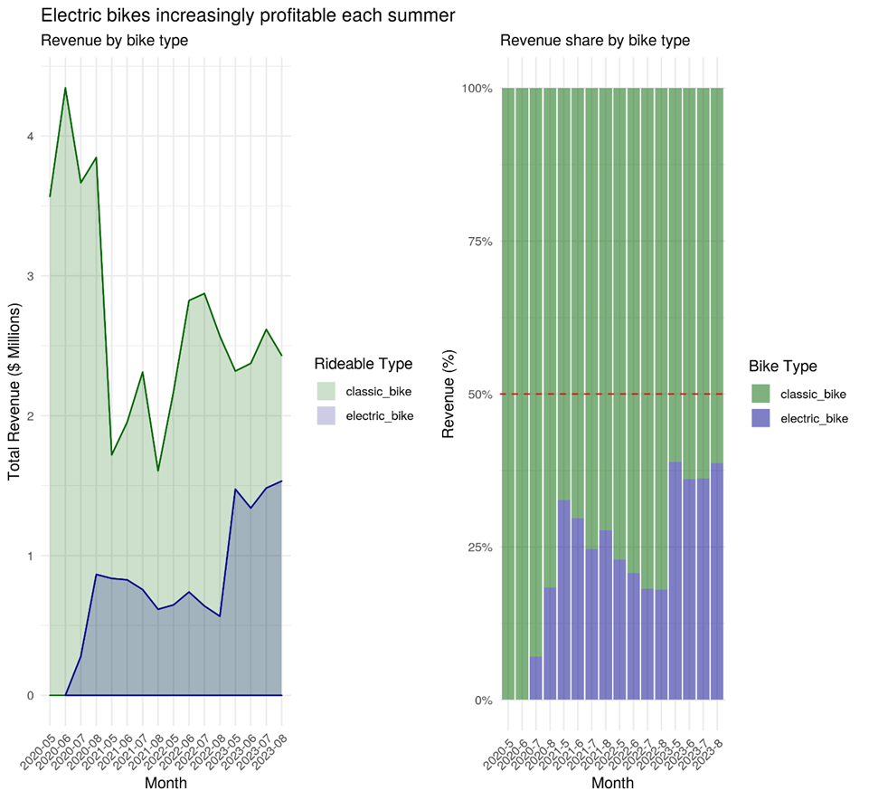
Income Analysis

Slide 18
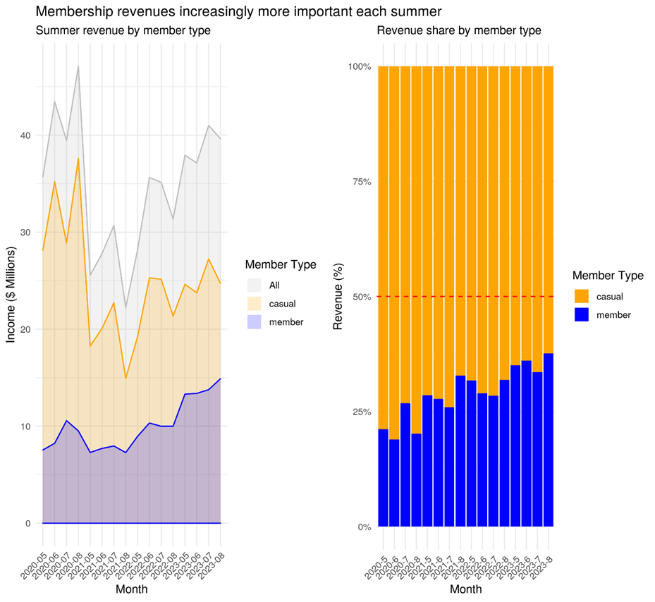
Income Analysis

Slide 19
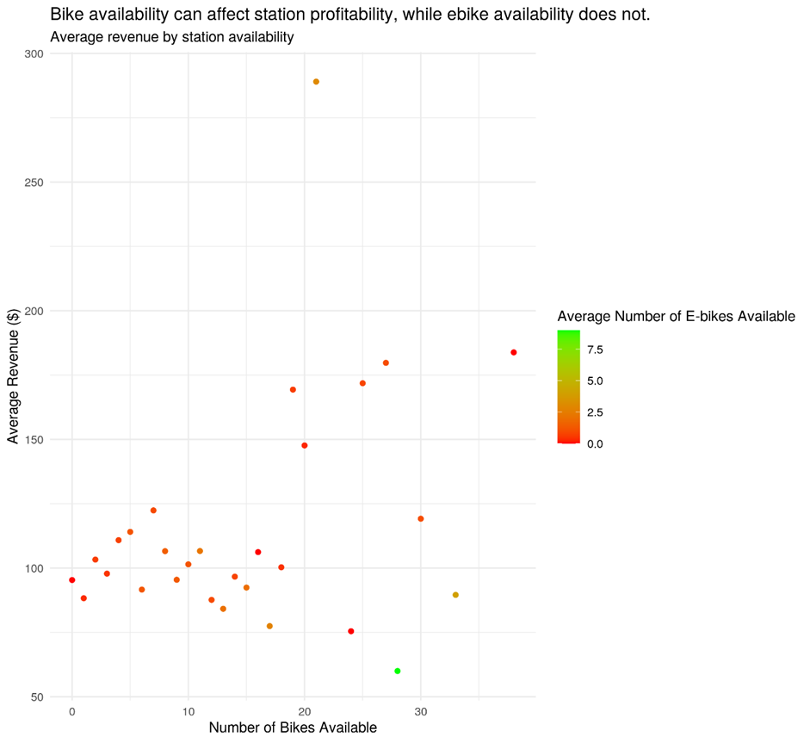
Income Analysis

Slide 20
Conclusion
Consistent Popular Stations
There are specific stations that are top locations for starting and ending rides, highlighting their importance to users.
Monthly Shifts
Station usage varies over time due to changes in user preferences, urban development, or accessibility.
Short Trip Preference
Most rides are between 5-20 minutes, indicating a preference for quick, convenient trips.
Stable Docked Bike Usage
Docked bike durations remain stable, while classic and electric bike durations have decreased over time.
Peak Usage Hours
Ride durations are highest between 11 AM and 5 PM, suggesting increased demand during these hours.

Slide 21
Conclusion
Member vs. Casual Rides
Members take shorter rides, while casual users have longer and more varied durations.
Decreasing Trend
Average ride durations have decreased over time, with significant drops year-on-year and seasonally from May to August.
Growing Importance of Electric Bikes
Electric bike revenue increases each summer, showing their growing popularity and profitability.
Membership Revenue Significance
Revenue from members is crucial, especially in summer, emphasizing the importance of promoting membership plans.
Impact of Bike Availability on Revenue
More bikes at stations correlate with higher average revenue, though e-bike availability does not significantly affect station profitability. ​

Slide 22


QUESTIONS

